Slide 1
TNGS Learning Solutions AWS Solutions Architect Online Course AWS Account SignUp

Slide 2
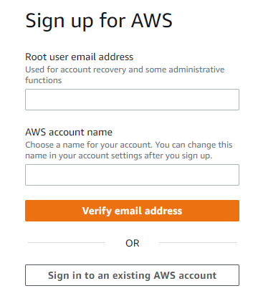
AWS signup step by step process
Click on the URL below to open AWS signup page
https://portal.aws.amazon.com/billing/signup#/start/email
Enter the following;
Root user email address
AWS account name
Click on Verify email Address
Check your email and
Provide Verification Code
Click on Verify

Slide 3
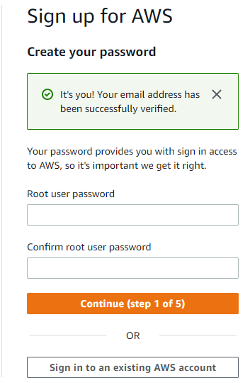
Enter;
Root user password
Confirm root user password
Click on Continue.

Slide 4
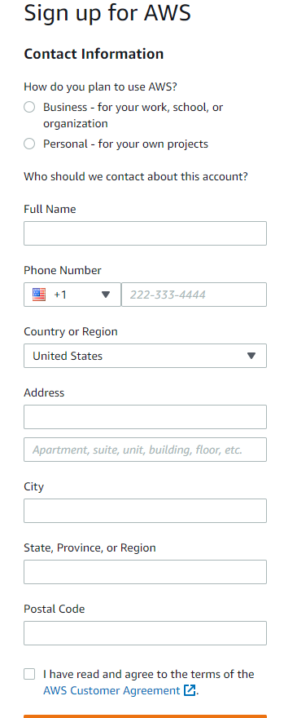
Select;
Personal –for your own project
Enter the following;
Full name
Phone number
Country or region
Address
City
State, Province, or Region
Postal Code
Select;
I have read and agree to the terms of the
Click on Continue.

Slide 5
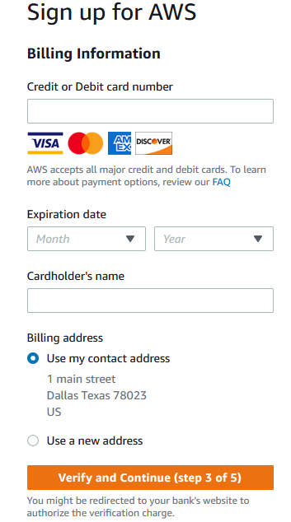
Then provide your credit/debit card details
Specify billing address

Slide 6
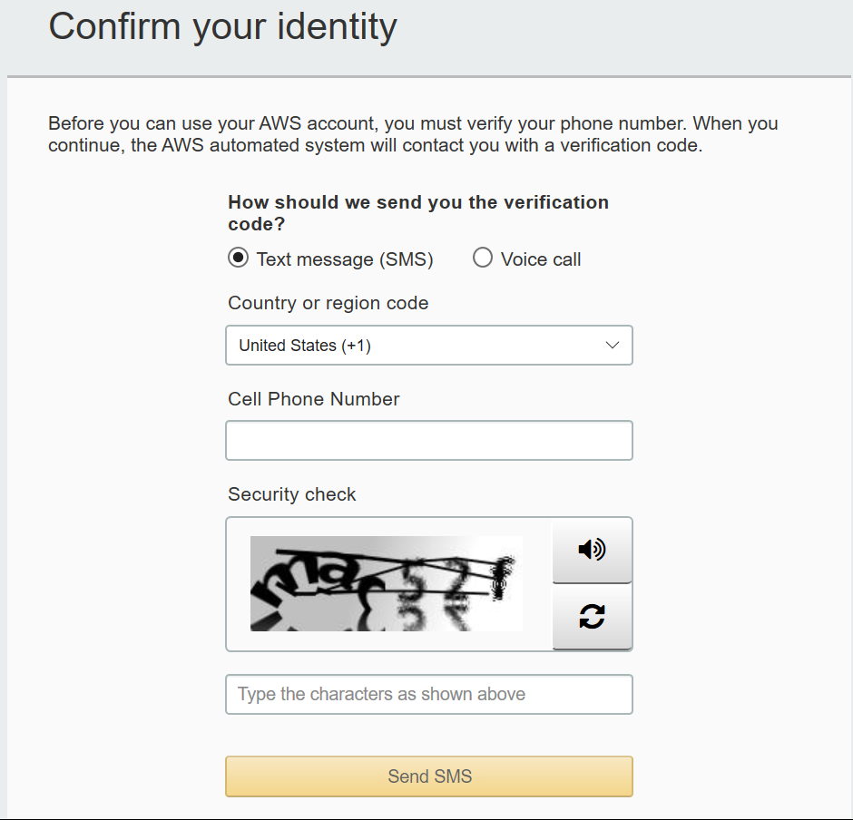
Enter your cell phone number for cell phone verification.
Enter Security Check code
Note ~ Select Text message (SMS) if you want to receive a verification text. Otherwise, select Voice call and you will receive a phone call on the provided phone number.
Click on call Me Now when you are ready.

Slide 7
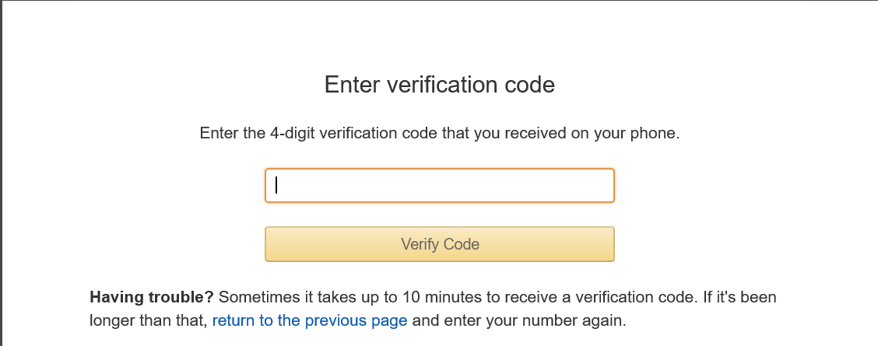
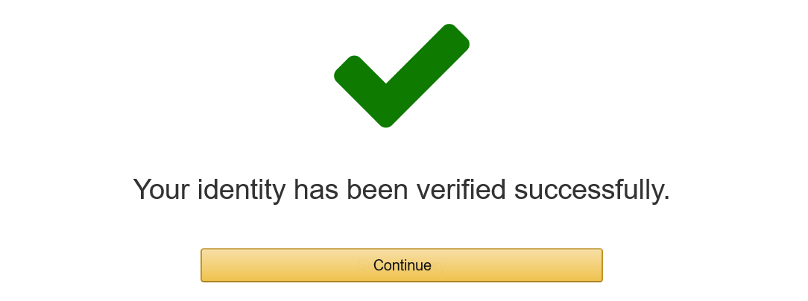
Once completed successfully, you will get a confirmation like this.

Slide 8
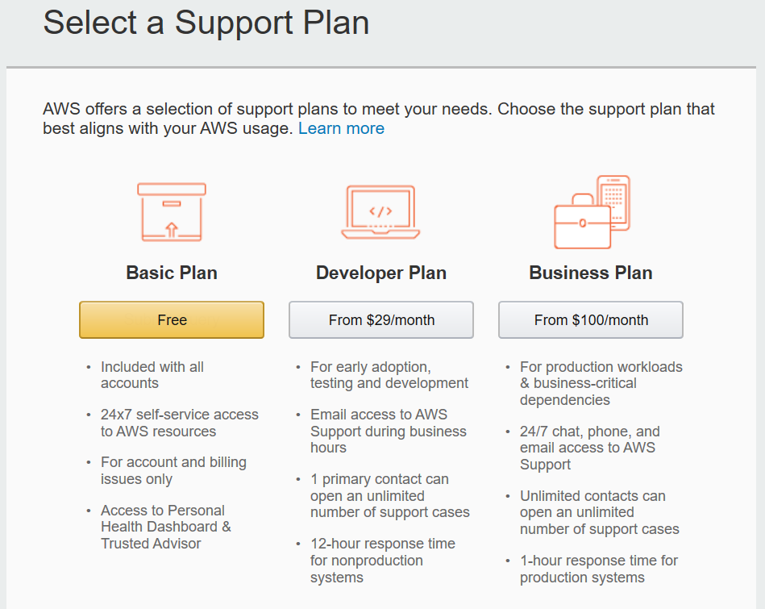
Next, select the support plan as Basic Plan which is free.
You can find the more information on the below link regarding the support plans and its features
https://aws.amazon.com/premiumsupport/plans/

Slide 9
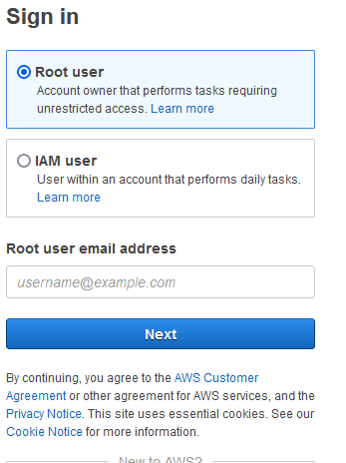
Enter your email address which you used to sign up at the beginning,
Click on Next.
Enter your password and click on sign in to sign into the AWS console.

Slide 10
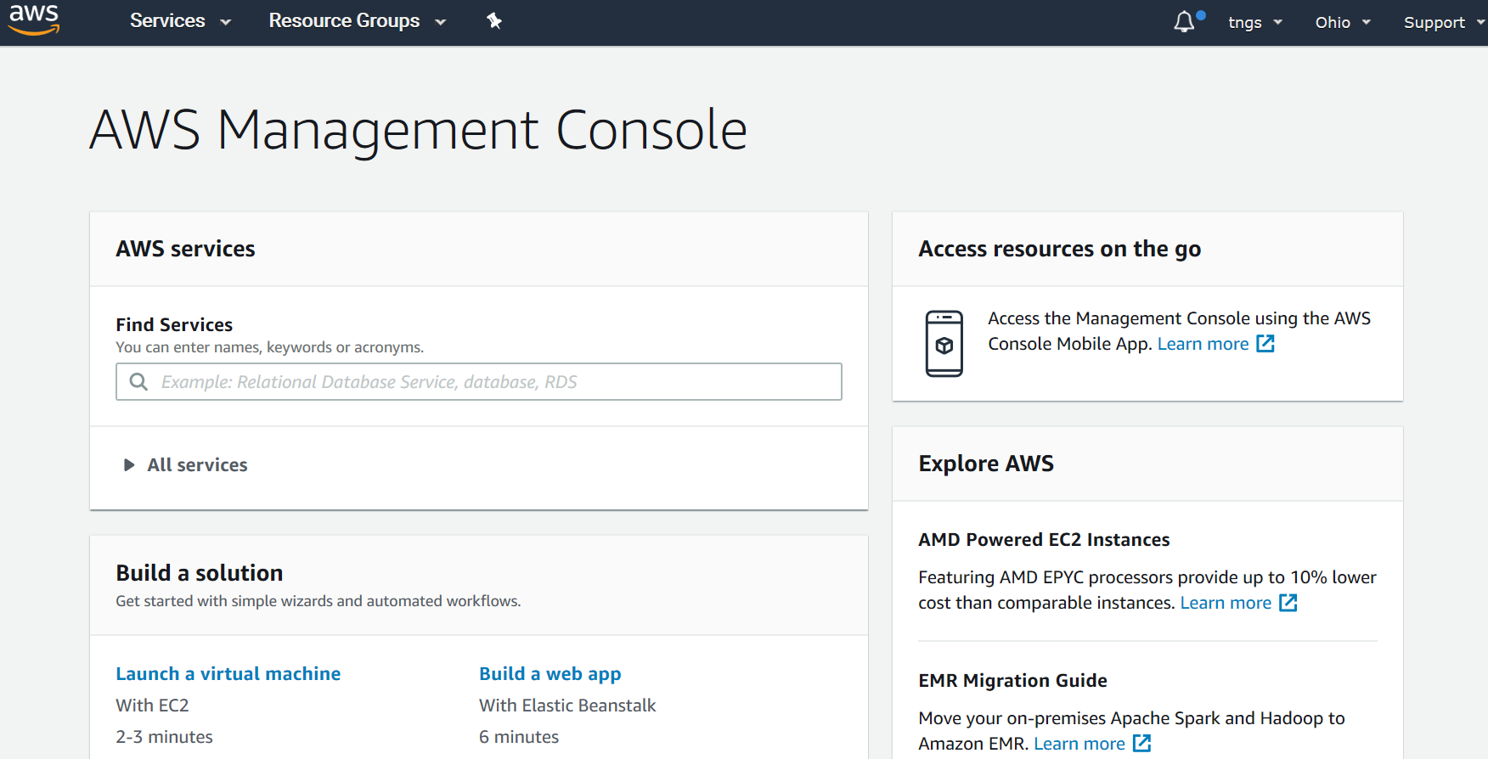
Once signed in, you have successfully created and logged into your AWS account.

